Slide 1
Retrieving Data Using the SQL SELECT Statement

Slide 2
Objectives
After completing this lesson, you should be able to do the following:
  List the capabilities of SQL SELECT statements
  Execute a basic SELECT statement
  Identify and use the key features of Oracle SQL Developer
Notes:
Oracle Database 10g: SQL Fundamentals I 1 - <number>
Objectives
To extract data from the database, you need to use the structured query language (SQL) SELECT statement. You may need to restrict the columns that are displayed. This lesson describes all the SQL statements that are needed to perform these actions. You may want to create SELECT statements that can be used more than once.
This lesson also covers the SQL Developer environment in which you execute SQL statements.

Slide 3
Capabilities of SQL SELECT Statements
Projection
Selection
Table 1
Table 1
Join
Table 1
Table 2
Notes:
Oracle Database 10g: SQL Fundamentals I 1 - <number>
Capabilities of SQL SELECT Statements
A SELECT statement retrieves information from the database. With a SELECT statement, you can use the following capabilities:
Projection: Choose the columns in a table that are returned by a query. Choose as few or as many of the columns as needed.
Selection: Choose the rows in a table that are returned by a query. Various criteria can be used to restrict the rows that are retrieved.
Joining: Bring together data that is stored in different tables by specifying the link between them. SQL joins are covered in more detail in the lesson titled “Displaying Data
from Multiple Tables.”

Slide 4
Basic SELECT Statement
  SELECT identifies the columns to be displayed.
  FROM identifies the table containing those columns.
SELECT *|{[DISTINCT] column|expression [alias],...}
FROM table;
Notes:
Oracle Database 10g: SQL Fundamentals I 1 - <number>
Basic SELECT Statement
In its simplest form, a SELECT statement must include the following:
A SELECT clause, which specifies the columns to be displayed
A FROM clause, which identifies the table containing the columns that are listed in the SELECT clause
In the syntax:
SELECT is a list of one or more columns
* selects all columns
DISTINCT suppresses duplicates
column|expression selects the named column or the expression
alias gives selected columns different headings
FROM table specifies the table containing the columns
Note: Throughout this course, the words keyword, clause, and statement are used as follows:
A keyword refers to an individual SQL element.
For example, SELECT and FROM are keywords.
A clause is a part of a SQL statement.
For example, SELECT employee_id, last_name, ... is a clause.
A statement is a combination of two or more clauses.
For example, SELECT * FROM employees is a SQL statement.

Slide 5
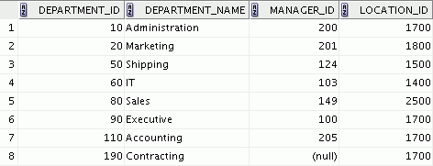
Selecting All Columns
SELECT *
FROM departments;
Notes:
Oracle Database 10g: SQL Fundamentals I 1 - <number>
Selecting All Columns of All Rows
You can display all columns of data in a table by following the SELECT keyword with an asterisk (*). In the example in the slide, the department table contains four columns: DEPARTMENT_ID, DEPARTMENT_NAME, MANAGER_ID, and LOCATION_ID. The table contains eight rows, one for each department.
You can also display all columns in the table by listing all the columns after the SELECT keyword. For example, the following SQL statement (like the example in the slide) displays all columns and all rows of the DEPARTMENTS table:
SELECT department_id, department_name, manager_id, location_id
FROM departments;

Slide 6
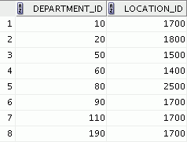
Selecting Specific Columns
SELECT department_id, location_id
FROM departments;
Notes:
Oracle Database 10g: SQL Fundamentals I 1 - <number>
Selecting Specific Columns of All Rows
You can use the SELECT statement to display specific columns of the table by specifying the column names, separated by commas. The example in the slide displays all the department numbers and location numbers from the DEPARTMENTS table.
In the SELECT clause, specify the columns that you want, in the order in which you want them to appear in the output. For example, to display location before department number going from left to right, you use the following statement:
SELECT location_id, department_id
FROM departments;

Slide 7
Writing SQL Statements
  SQL statements are not case-sensitive.
  SQL statements can be on one or more lines.
  Keywords cannot be abbreviated or split
  across lines.
  Clauses are usually placed on separate lines.
  Indents are used to enhance readability.
  In SQL Developer, SQL statements can optionally be terminated by a semicolon (;). Semicolons are required if you execute multiple SQL statements.
  In SQL*Plus, you are required to end each SQL statement with a semicolon (;).
Notes:
Oracle Database 10g: SQL Fundamentals I 1 - <number>
Writing SQL Statements
Using the following simple rules and guidelines, you can construct valid statements that are both easy to read and easy to edit:
SQL statements are not case-sensitive (unless indicated).
SQL statements can be entered on one or many lines.
• Keywords cannot be split across lines or abbreviated.
Clauses are usually placed on separate lines for readability and ease of editing.
• Indents should be used to make code more readable.
Keywords typically are entered in uppercase; all other words, such as table names and columns, are entered in lowercase.
Executing SQL Statements
Using SQL Developer, click the Execute button to run the command or commands in the editing window.
Using SQL*Plus, terminate the SQL statement with a semicolon and then press the Enter key to run the command.

Slide 8
Column Heading Defaults
  SQL Developer:
    Default heading alignment: Center
    Default heading display: Uppercase
  SQL*Plus:
    Character and Date column headings are left-aligned
    Number column headings are right-aligned
    Default heading display: Uppercase
Notes:
Oracle Database 10g: SQL Fundamentals I 1 - <number>
Column Heading Defaults
In SQL Developer, column headings are displayed in uppercase and centered.
SELECT last_name, hire_date, salary
FROM employees;
You can override the column heading display with an alias. Column aliases are covered later in this lesson.

Slide 9
Arithmetic Expressions
Create expressions with number and date data by using arithmetic operators.
Operator | Description
+ | Add
- | Subtract
* | Multiply
/ | Divide
Notes:
Oracle Database 10g: SQL Fundamentals I 1 - <number>
Arithmetic Expressions
You may need to modify the way in which data is displayed, or you may want to perform calculations or look at what-if scenarios. These are all possible using arithmetic expressions. An arithmetic expression can contain column names, constant numeric values, and the arithmetic operators.
Arithmetic Operators
The slide lists the arithmetic operators that are available in SQL. You can use arithmetic operators in any clause of a SQL statement (except the FROM clause).
Note: With the DATE and TIMESTAMP data types, you can use the addition and subtraction operators only.

Slide 10
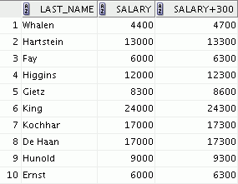
Using Arithmetic Operators
SELECT last_name, salary, salary + 300
FROM employees;
…
Notes:
Oracle Database 10g: SQL Fundamentals I 1 - <number>
Using Arithmetic Operators
The example in the slide uses the addition operator to calculate a salary increase of $300 for all employees. The slide also displays a SALARY+300 column in the output.
Note that the resultant calculated column SALARY+300 is not a new column in the EMPLOYEES table; it is for display only. By default, the name of a new column comes from the calculation that generated it—in this case, salary+300.
Note: The Oracle server ignores blank spaces before and after the arithmetic operator.
Operator Precedence
If an arithmetic expression contains more than one operator, multiplication and division are evaluated first. If operators in an expression are of the same priority, then evaluation is done from left to right.
You can use parentheses to force the expression that is enclosed by parentheses to be evaluated first.
Rules of Precedence:
Multiplication and division occur before addition and subtraction.
Operators of the same priority are evaluated from left to right.
Parentheses are used to override the default precedence or to clarify the statement.

Slide 11


Operator Precedence
SELECT last_name, salary, 12*salary+100
FROM employees;
1
…
SELECT last_name, salary, 12*(salary+100)
FROM employees;
2
…
Notes:
Oracle Database 10g: SQL Fundamentals I 1 - <number>
Operator Precedence (continued)
The first example in the slide displays the last name, salary, and annual compensation of employees. It calculates the annual compensation by multiplying the monthly salary by 12, plus a one-time bonus of $100. Note that multiplication is performed before addition.
Note: Use parentheses to reinforce the standard order of precedence and to improve clarity. For example, the expression in the slide can be written as (12*salary)+100 with no change in the result.
Using Parentheses
You can override the rules of precedence by using parentheses to specify the desired order in which operators are to be executed.
The second example in the slide displays the last name, salary, and annual compensation of employees. It calculates the annual compensation as follows: adding a monthly bonus of $100 to the monthly salary, and then multiplying that subtotal by 12. Because of the parentheses, addition takes priority over multiplication.

Slide 12


Defining a Null Value
  A null is a value that is unavailable, unassigned, unknown, or inapplicable.
  A null is not the same as a zero or a blank space.
SELECT last_name, job_id, salary, commission_pct
FROM employees;
…
Notes:
Oracle Database 10g: SQL Fundamentals I 1 - <number>
Null Values
If a row lacks a data value for a particular column, that value is said to be null or to contain a null.
A null is a value that is unavailable, unassigned, unknown, or inapplicable. A null is not the same as a zero or a space. Zero is a number, and a space is a character.
Columns of any data type can contain nulls. However, some constraints (NOT NULL and PRIMARY KEY) prevent nulls from being used in the column.
In the COMMISSION_PCT column in the EMPLOYEES table, notice that only a sales manager or sales representative can earn a commission. Other employees are not entitled to earn commissions. A null represents that fact.

Slide 13
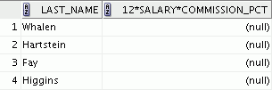

Null Values in Arithmetic Expressions
Arithmetic expressions containing a null value evaluate to null.
SELECT last_name, 12*salary*commission_pct
FROM employees;
…
Notes:
Oracle Database 10g: SQL Fundamentals I 1 - <number>
Null Values in Arithmetic Expressions
If any column value in an arithmetic expression is null, the result is null. For example, if you attempt to perform division by zero, you get an error. However, if you divide a number by null, the result is a null or unknown.
In the example in the slide, employee King does not get any commission. Because the COMMISSION_PCT column in the arithmetic expression is null, the result is null.
For more information, see “Basic Elements of SQL” in SQL Reference.

Slide 14
Defining a Column Alias
A column alias:
  Renames a column heading
  Is useful with calculations
  Immediately follows the column name (There can also be the optional AS keyword between the column name and alias.)
  Requires double quotation marks if it contains spaces or special characters, or if it is case-sensitive
Notes:
Oracle Database 10g: SQL Fundamentals I 1 - <number>
Column Aliases
When displaying the result of a query, SQL Developer normally uses the name of the selected column as the column heading. This heading may not be descriptive and, therefore, maybe difficult to understand. You can change a column heading by using a column alias.
Specify the alias after the column in the SELECT list using a space as a separator. By default, alias headings appear in uppercase. If the alias contains spaces or special characters (such as # or $), or if it is case-sensitive, enclose the alias in double quotation marks (" ").

Slide 15


Using Column Aliases
SELECT last_name AS name, commission_pct comm
FROM employees;
…
SELECT last_name "Name" , salary*12 "Annual Salary"
FROM employees;
…
Notes:
Oracle Database 10g: SQL Fundamentals I 1 - <number>
Column Aliases (continued)
The first example displays the names and the commission percentages of all the employees. Notice that the optional AS keyword has been used before the column alias name. The result of the query is the same whether the AS keyword is used or not. Also notice that the SQL statement has the column aliases, name and comm, in lowercase, whereas the result of the query displays the column headings in uppercase. As mentioned in a previous slide, column headings appear in uppercase by default.
The second example displays the last names and annual salaries of all the employees. Because Annual Salary contains a space, it has been enclosed in double quotation marks. Notice that the column heading in the output is exactly the same as the column alias.

Slide 16
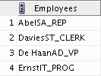
Concatenation Operator
A concatenation operator:
  Links columns or character strings to other columns
  Is represented by two vertical bars (||)
  Creates a resultant column that is a character expression
SELECT last_name||job_id AS "Employees"
FROM employees;
…
Notes:
Oracle Database 10g: SQL Fundamentals I 1 - <number>
Concatenation Operator
You can link columns to other columns, arithmetic expressions, or constant values to create a character expression by using the concatenation operator (||). Columns on either side of the operator are combined to make a single output column.
In the example, LAST_NAME and JOB_ID are concatenated, and they are given the alias Employees. Notice that the employee last name and job code are combined to make a single output column.
The AS keyword before the alias name makes the SELECT clause easier to read.
Null Values with the Concatenation Operator
If you concatenate a null value with a character string, the result is a character string. LAST_NAME || NULL results in LAST_NAME.

Slide 17
Literal Character Strings
  A literal is a character, a number, or a date that is included in the SELECT statement.
  Date and character literal values must be enclosed by single quotation marks.
  Each character string is output once for each
  row returned.
Notes:
Oracle Database 10g: SQL Fundamentals I 1 - <number>
Literal Character Strings
A literal is a character, a number, or a date that is included in the SELECT list and that is not a column name or a column alias. It is printed for each row returned. Literal strings of free-format text can be included in the query result and are treated the same as a column in the SELECT list.
Date and character literals must be enclosed by single quotation marks (' '); number literals need not be so enclosed.

Slide 18
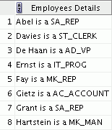
Using Literal Character Strings
SELECT last_name ||' is a '||job_id
AS "Employee Details"
FROM employees;
…
Notes:
Oracle Database 10g: SQL Fundamentals I 1 - <number>
Literal Character Strings (continued)
The example in the slide displays last names and job codes of all employees. The column has the heading Employee Details. Notice the spaces between the single quotation marks in the SELECT statement. The spaces improve the readability of the output.
In the following example, the last name and salary for each employee are concatenated with a literal to give the returned rows more meaning:
SELECT last_name ||': 1 Month salary = '||salary Monthly
FROM employees;
…

Slide 19

Alternative Quote (q) Operator
  Specify your own quotation mark delimiter.
  Choose any delimiter.
  Increase readability and usability.
SELECT department_name ||
q'[, it's assigned Manager Id: ]'
|| manager_id
AS "Department and Manager"
FROM departments;
…
Notes:
Oracle Database 10g: SQL Fundamentals I 1 - <number>
Alternative Quote (q) Operator
Many SQL statements use character literals in expressions or conditions. If the literal itself contains a single quotation mark, you can use the quote (q) operator and choose your own quotation mark delimiter.
You can choose any convenient delimiter, single-byte or multibyte, or any of the following character pairs: [ ], { }, ( ), or < >.
In the example shown, the string contains a single quotation mark, which is normally interpreted as a delimiter of a character string. By using the q operator, however, the brackets [] are used as the quotation mark delimiter. The string between the brackets delimiters is interpreted as a literal character string.

Slide 20
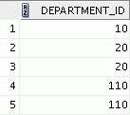
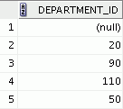
Duplicate Rows
The default display of queries is all rows, including duplicate rows.
1
2
SELECT department_id
FROM employees;
SELECT DISTINCT department_id
FROM employees;
…
…
Notes:
Oracle Database 10g: SQL Fundamentals I 1 - <number>
Duplicate Rows
Unless you indicate otherwise, SQL Developer displays the results of a query without eliminating duplicate rows. The first example in the slide displays all the department numbers from the EMPLOYEES table. Notice that the department numbers are repeated.
To eliminate duplicate rows in the result, include the DISTINCT keyword in the SELECT clause immediately after the SELECT keyword. In the second example in the slide, the EMPLOYEES table actually contains 20 rows, but there are only seven unique department numbers in the table.
You can specify multiple columns after the DISTINCT qualifier. The DISTINCT qualifier affects all the selected columns, and the result is every distinct combination of the columns.
SELECT DISTINCT department_id, job_id
FROM employees;

Slide 21
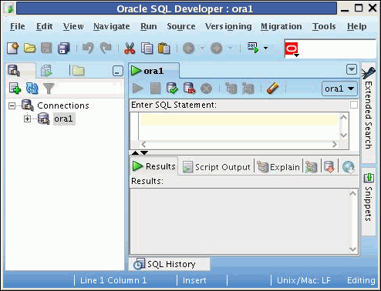
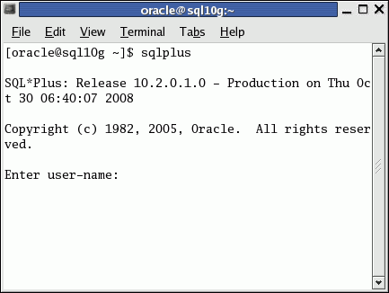
Development Environments for SQL
In this course:
  Primarily use Oracle SQL Developer 1.5.1
  Use SQL*Plus:
    In case you do not have access to Oracle SQL Developer
    Or when any command does not run in Oracle SQL Developer
SQL *Plus
SQL Developer
Notes:
Oracle Database 10g: SQL Fundamentals I 1 - <number>
Development Environments for SQL
This course has been developed using Oracle SQL Developer as the tool for running the SQL statements discussed in the examples in the slide and the practices. For commands that are not supported by Oracle SQL Developer, use the SQL*Plus environment.

Slide 22

What Is Oracle SQL Developer?
  Oracle SQL Developer is a graphical tool that enhances productivity and simplifies database development tasks.
  You can connect to any target Oracle Database schema by using the standard Oracle Database authentication.
SQL Developer
Notes:
Oracle Database 10g: SQL Fundamentals I 1 - <number>
What Is Oracle SQL Developer?
Oracle SQL Developer is a free graphical tool designed to improve your productivity and simplify the development of everyday database tasks. With just a few clicks, you can easily create and debug stored procedures, test SQL statements, and view optimizer plans.
Oracle SQL Developer, the visual tool for database development, simplifies the following tasks:
Browsing and managing database objects
Executing SQL statements and scripts
Editing and debugging PL/SQL statements
Creating reports
You can connect to any target Oracle Database schema by using the standard Oracle Database authentication. When connected, you can perform operations on objects in the database.

Slide 23
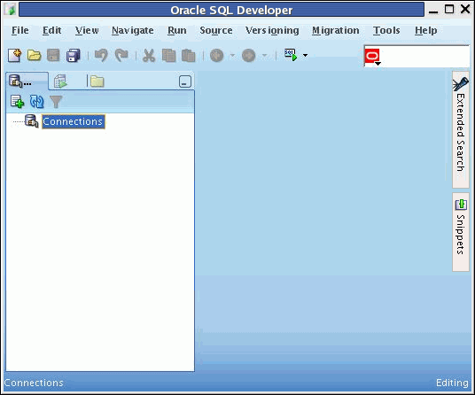
Oracle SQL Developer Interface
You must define a connection to start using SQL Developer for running SQL queries on a database schema.
Notes:
Oracle Database 10g: SQL Fundamentals I 1 - <number>
Oracle SQL Developer Interface
Oracle SQL Developer has two main navigation tabs:
Connections tab: By using this tab, you can browse database objects and users to which you have access.
Reports tab: By using this tab, you can run predefined reports, or create and add your own reports.
Oracle SQL Developer uses the left pane for navigation to find and select objects, and the right pane to display information about selected objects. You can customize many aspects of the appearance and behavior of Oracle SQL Developer by setting preferences. The menus at the top contain standard entries, plus entries for features specific to Oracle SQL Developer.
Note: You must define at least one connection to be able to connect to a database schema and issue SQL queries or run procedures/functions.

Slide 24
Creating a Database Connection
  You must have at least one database connection to use Oracle SQL Developer.
  You can create and test connections for:
    Multiple databases
    Multiple schemas
  Oracle SQL Developer automatically imports any connections defined in the tnsnames.ora file on your system.
  You can export connections to an XML file.
  Each additional database connection created is listed in the Connections Navigator hierarchy.
Notes:
Oracle Database 10g: SQL Fundamentals I 1 - <number>
Creating a Database Connection
A connection is an Oracle SQL Developer object that specifies the necessary information for connecting to a specific database as a specific user of that database. To use Oracle SQL Developer, you must have at least one database connection, which may be existing, created, or imported.
You can create and test connections for multiple databases and for multiple schemas.
By default, the tnsnames.ora file is located in the $ORACLE_HOME/network/admin directory. But, it can also be in the directory specified by the TNS_ADMIN environment variable or the registry value. When you start Oracle SQL Developer and display the Database Connections dialog box, Oracle SQL Developer automatically imports any connections defined in the tnsnames.ora file on your system.
Note: On Windows systems, if the tnsnames.ora file exists but Oracle SQL Developer is not using its connections, define TNS_ADMIN as a system environment variable.
You can export connections to an XML file so that you can reuse it later.
You can create additional connections as different users to the same database or to connect to the different databases.

Slide 25
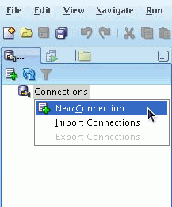
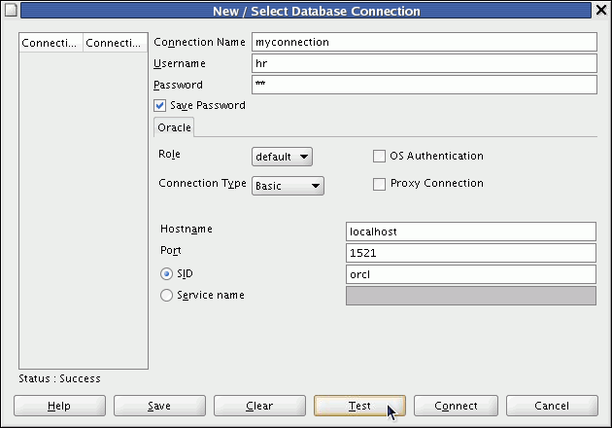
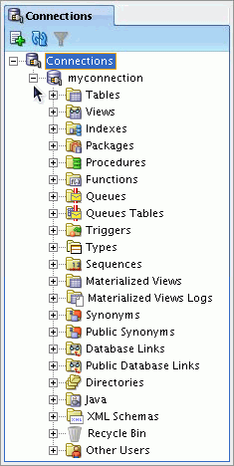
Creating a Database Connection
1
2
3
Notes:
Oracle Database 10g: SQL Fundamentals I 1 - <number>
Creating a Database Connection (continued)
To create a database connection, perform the following steps:
1. On the Connections tabbed page, right-click Connections and select New Connection.
2. In the New/Select Database Connection window, enter the connection name. Enter the username and password of the schema that you want to connect to.
1. From the Role drop-down list, you can select either default or SYSDBA (you will select SYSDBA for the sys user or any user with DBA privileges).
2. You can select the connection type as:
- Basic: In this type, you enter the host name and system identifier (SID) for the database that you want to connect to. The Port is already set to 1521. Or, you can also enter the Service name directly if you are using a remote database connection.
- TNS: You select any one of the database aliases imported from the tnsnames.ora file
- Advanced: You define a custom JDBC URL to connect to the database.
3. Click Test to make sure that the connection has been set correctly.
4. Click Connect.
If you select the Save Password check box, the password is saved to an XML file. So, after you close the Oracle SQL Developer connection and open it again, you will not be prompted for the password.

Slide 26
Notes:
Oracle Database 10g: SQL Fundamentals I 1 - <number>
Creating a Database Connection (continued)
3. The connection gets added in the Connections Navigator. You can expand the connection to view the database objects and view object definitions, for example, dependencies, details, statistics, and so on.

Slide 27
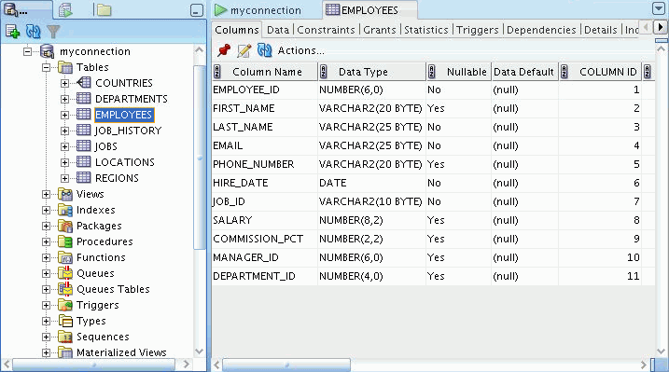
Browsing Database Objects
Use the Connections Navigator to:
  Browse through many objects in a database schema
  Review the definitions of objects at a glance
Notes:
Oracle Database 10g: SQL Fundamentals I 1 - <number>
Browsing Database Objects
After you have created a database connection, you can use the Connections Navigator to browse through many objects in a database schema including Tables, Views, Indexes, Packages, Procedures, Triggers, Types, and so on.
Oracle SQL Developer uses the left pane for navigation to find and select objects and the right pane to display information about the selected objects. You can customize many aspects of the appearance of Oracle SQL Developer by setting preferences.
You can see the definition of the objects broken into tabs of information that is pulled out of the data dictionary. For example, if you select a table in the Navigator, the details about columns, constraints, grants, statistics, triggers, and so on are displayed in an easy-to-read tabbed page.
If you want to see the definition of the EMPLOYEES table as shown in the slide, perform the following steps:
1. Expand the Connections node in the Connections Navigator.
2. Expand Tables.
3. Click EMPLOYEES. By default, the Columns tab is selected. It shows the column description of the table. By using the Data tab, you can view the data in the table and also enter new rows, update data, and commit these changes to the database.

Slide 28
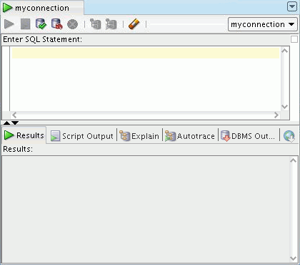
Using the SQL Worksheet
  Use the SQL Worksheet to enter and execute SQL, PL/SQL, and SQL*Plus statements.
  Specify any actions that can be processed by the database connection associated with the Worksheet.
Enter SQL Statements.
Results are shown here.
Notes:
Oracle Database 10g: SQL Fundamentals I 1 - <number>
Using the SQL Worksheet
When you connect to a database, a SQL Worksheet window for that connection is automatically opened. You can use the SQL Worksheet to enter and execute SQL, PL/SQL, and SQL*Plus statements. All SQL and PL/SQL commands are supported as they are passed directly from the SQL Worksheet to the Oracle Database. However, the SQL*Plus commands used in Oracle SQL Developer have to be interpreted by the SQL Worksheet before being passed to the database.
The SQL Worksheet currently supports a number of SQL*Plus commands. Those commands that are not supported by the SQL Worksheet are ignored and not sent to the Oracle Database. Through the SQL Worksheet, you can execute SQL statements and some of the SQL*Plus commands.
You can display a SQL Worksheet by using any of the following two options:
Select Tools > SQL Worksheet.
Click the Open SQL Worksheet icon available on the main toolbar.

Slide 29
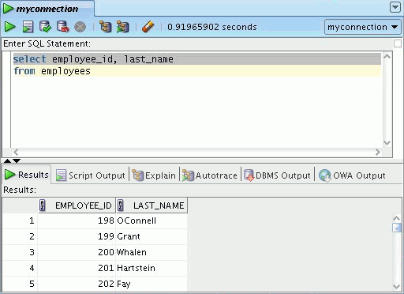
Using the SQL Worksheet
1
2
4
6
7
5
8
3
Notes:
Oracle Database 10g: SQL Fundamentals I 1 - <number>
Using the SQL Worksheet (continued)
You may want to use shortcut keys or icons to perform certain tasks, such as executing a SQL statement, running a script, or viewing the history of the SQL statements that you have executed.
You can use the SQL Worksheet toolbar that contains icons to perform the following tasks:
1. Execute Statement: This executes the statement at the cursor in the Enter SQL Statement box. Alternatively, you can press [F9]. The output is generally shown in a formatted manner in the Results tab page.
2. Run Script: This executes all statements in the Enter SQL Statement box using the Script Runner. The output is generally shown in the conventional script format in the Scripts tab page.
3. Commit: This writes any changes to the database and ends the transaction.
4. Rollback: This discards any changes to the database, without writing them to the database, and ends the transaction.
5. Cancel: This stops the execution of any statements currently being executed.
6. Execute Explain Plan: This generates the execution plan, which you can see by clicking the Explain tab.

Slide 30
Notes:
Oracle Database 10g: SQL Fundamentals I 1 - <number>
Using the SQL Worksheet (continued)
7. Autotrace: This displays trace-related information when you execute the SQL statement by clicking the Autotrace icon. This information can help you to identify the SQL statements that will benefit from tuning.
8. Clear: This erases the statement or statements in the Enter SQL Statement box. Alternatively, press and hold [Ctrl] + [D] to erase the statements.

Slide 31
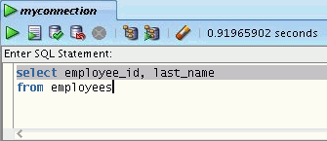
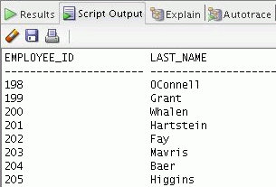
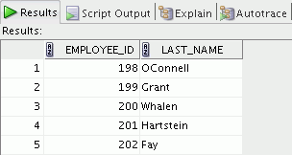
Executing SQL Statements
Use the Enter SQL Statement box to enter single or multiple SQL statements.
F9
F5
F5
F9
Notes:
Oracle Database 10g: SQL Fundamentals I 1 - <number>
Executing SQL Statements
In the SQL Worksheet, you can use the Enter SQL Statement box to enter a single or multiple SQL statements. For a single statement, the semicolon at the end is optional.
When you enter the statement, the SQL keywords are automatically highlighted. To execute a SQL statement, ensure that your cursor is within the statement and click the Execute Statement icon. Alternatively, you can press [F9].
To execute multiple SQL statements and see the results, click the Run Script icon. Alternatively, you can press [F5].
The example in the slide shows the difference in output for the same query when F9 key or Execute Statement is used versus the output when F5 or Run Script is used.

Slide 32
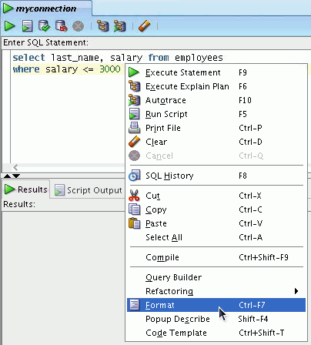
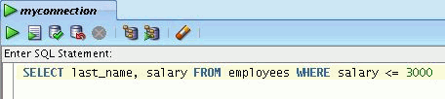
Formatting the SQL Code
Before
formatting
After
formatting
Notes:
Oracle Database 10g: SQL Fundamentals I 1 - <number>
Formatting the SQL Code
You may want to beautify the indentation, spacing, capitalization, and the line separation of the SQL code. Oracle SQL Developer has the feature for formatting the SQL code.
To format the SQL code, right-click in the statement area, and select Format SQL.
In the example in the slide, before formatting, the keywords are not capitalized and the statement is not properly indented in the SQL code. After formatting, the SQL code is beautified with the keywords capitalized and the statement properly indented, if needed.

Slide 33
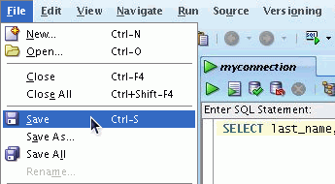
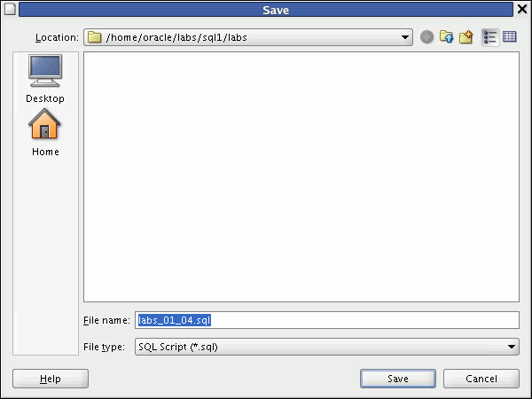

Saving SQL Statements
1
2
3
Notes:
Oracle Database 10g: SQL Fundamentals I 1 - <number>
Saving SQL Statements
In most of the practices that you will perform, you will need to save a particular query in the SQL Worksheet as a .sql file. To do so, perform the following:
1. From the File menu, select Save or Save As (if you are renaming a current .sql script). Alternatively, you can press and hold [CTRL] + [S].
2. In the Save dialog box, enter the appropriate filename. Make sure the extension is .sql or the File type is selected as SQL Script (*.sql). Click Save.
Note: For this course, you need to save your sql scripts in the \home\oracle\labs\sql1\labs folder.
3. The SQL Worksheet is renamed to the filename that you saved the script as. Make sure you do not enter any other SQL statements in the same worksheet. To continue with other SQL queries, open a new worksheet.

Slide 34
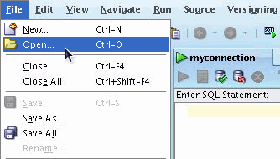
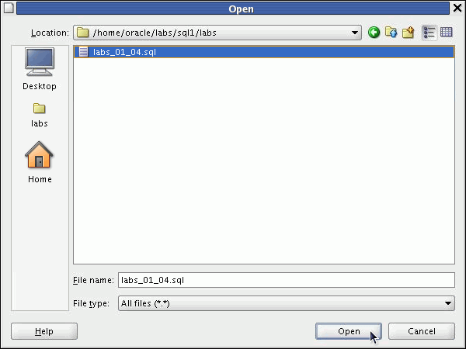
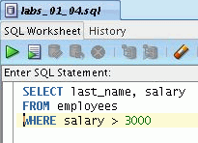
Running Script Files
1
3
2
Notes:
Oracle Database 10g: SQL Fundamentals I 1 - <number>
Running Script Files
To run the saved .sql script files, perform the following:
1. From the File menu, select Open. Alternatively, you can press and hold [CTRL] + [O].
2. In the Open dialog box, move to the \home\oracle\labs\sql1\labs folder, or to the location in which you saved the script file, select the file and click Open.
The script file opens in a new worksheet. Now, you can run the script by either clicking the Execute Statement icon or the Run Script icon. Again, make sure you do not enter any other SQL statements in the same worksheet. To continue with other SQL queries, open a new worksheet.
Note: You may want to set the default directory to \home\oracle\labs\sql1 folder, so that every time you try to open or save a script, SQL Developer chooses the same path to look for scripts. From Tools menu, select Preferences. In the Preferences dialog box, expand Database and select Worksheet Parameters. In the right pane, click Browse to set the default path to look for scripts and click OK.
Note: For more details on how to use the Oracle SQL Developer GUI interface for other data objects creation and data retrieval tasks, refer to Appendix E “Using SQL Developer.”

Slide 35
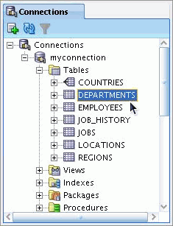
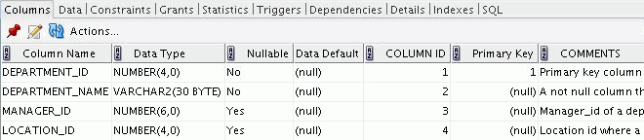
Displaying the Table Structure
  Use the DESCRIBE command to display the structure of a table.
  Or, select the table in the Connections tree and use the Columns tab to view the table structure.
DESC[RIBE] tablename
Notes:
Oracle Database 10g: SQL Fundamentals I 1 - <number>
Displaying the Table Structure
In SQL Developer, you can display the structure of a table by using the DESCRIBE command. The command displays the column names and the data types, and it shows you whether a column must contain data (that is, whether the column has a NOT NULL constraint).
In the syntax, table name is the name of any existing table, view, or synonym that is accessible to the user.
Using the SQL Developer GUI interface, you can select the table in the Connections tree and use the Columns tab to view the table structure.
Note: The DESCRIBE command is supported by both SQL*Plus and SQL Developer.

Slide 36
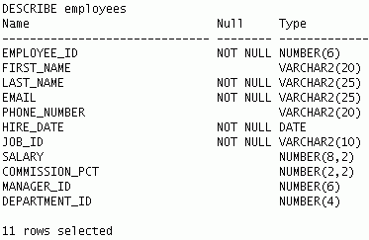
Using the DESCRIBE Command
DESCRIBE employees
Notes:
Oracle Database 10g: SQL Fundamentals I 1 - <number>
Using the DESCRIBE Command
The example in the slide displays information about the structure of the EMPLOYEES table using the DESCRIBE command.
In the resulting display, Null indicates that the values for this column may be unknown. NOT NULL indicates that a column must contain data. Type displays the data type for a column.
The data types are described in the following table:

Slide 37
Summary
In this lesson, you should have learned how to:
  Write a SELECT statement that:
    Returns all rows and columns from a table
    Returns specified columns from a table
    Uses column aliases to display more descriptive column headings
  Use the SQL Developer environment to write, save, and execute SQL statements
SELECT *|{[DISTINCT] column|expression [alias],...}
FROM table;
Notes:
Oracle Database 10g: SQL Fundamentals I 1 - <number>
Summary
In this lesson, you should have learned how to retrieve data from a database table with the SELECT statement.
SELECT *|{[DISTINCT] column [alias],...}
FROM table;
In the syntax:
SELECT is a list of one or more columns
* selects all columns
DISTINCT suppresses duplicates
column|expression selects the named column or the expression
alias gives selected columns different headings
FROM table specifies the table containing the columns
SQL Developer
SQL Developer is an execution environment that you can use to send SQL statements to the database server and to edit and save SQL statements. Statements can be executed from the SQL prompt or from a script file.

